Slide 1
The 68%, 95%, or 99.7% Rule
or
The Empirical Rule

Slide 2
The 68%, 95%, or 99.7% Rule
For a data set that is normally distributed:
∼68% of the data falls within 1 standard deviation of the mean
∼95% of the data falls within 2 standard deviations of the mean
∼99.7% of the data falls within 3 standard deviations of the mean

Slide 3
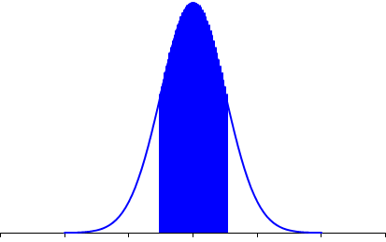
68%

Slide 4
34%
34%

Slide 5
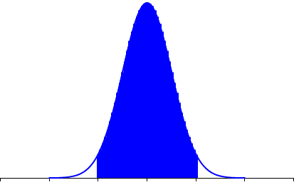
95%

Slide 6
47.5%
47.5%

Slide 7
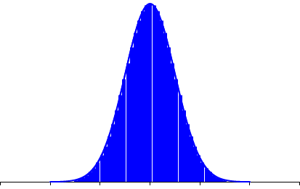
99.7%

Slide 8
49.85%
49.85%

Slide 9
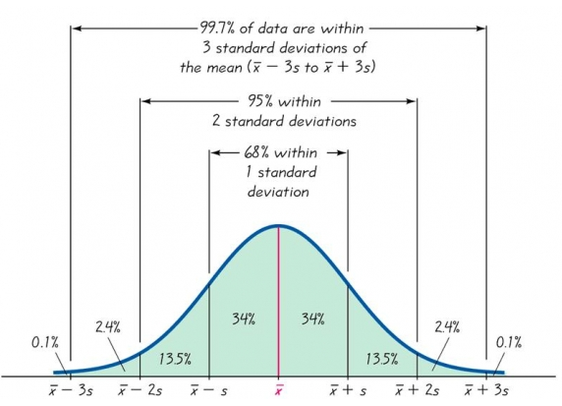
0.15%
2.35%
2.35%
0.15%
Source: Bowman, The Empirical Rule, http://rchsbowman.wordpress.com/2008/09/16/statistics-notes-—-interpreting-standard-deviation-—-the-empirical-rule-68-95-997-rule/ , 4/26/09

Slide 10
The 68%, 95%, or 99.7% Rule
or
The Empirical Rule

